Slide 1
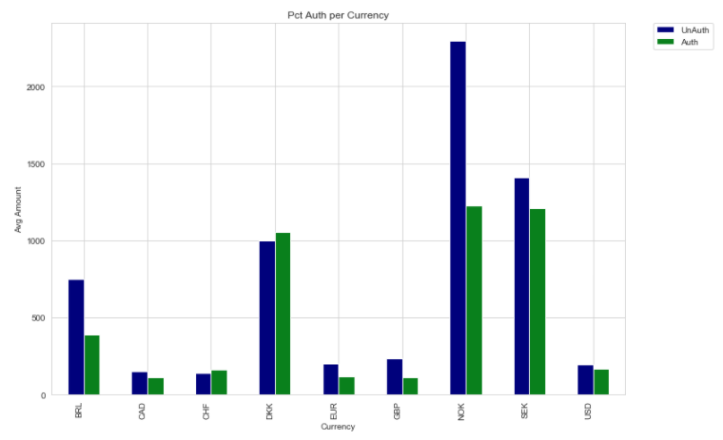
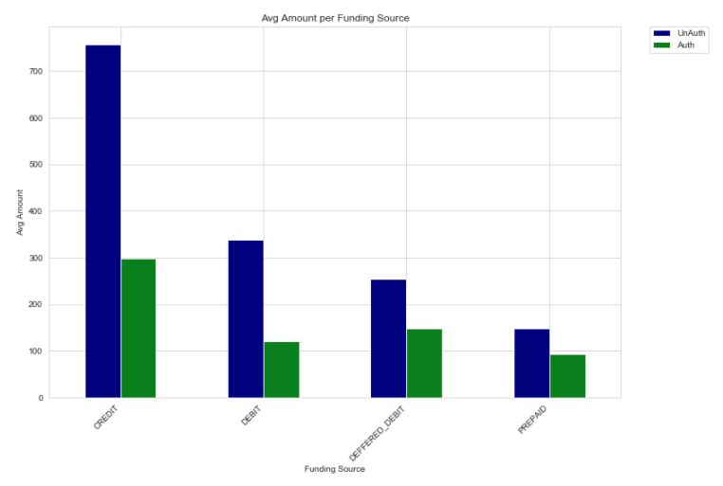
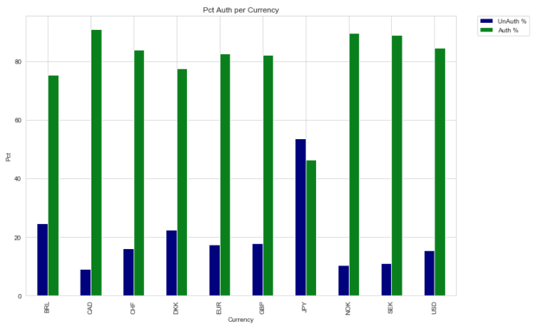
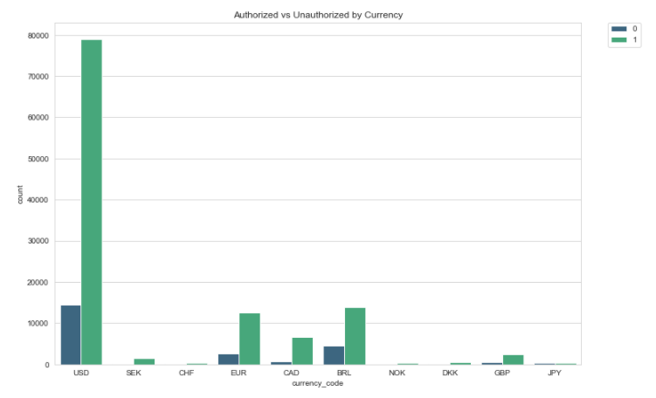
Notes:
Notes:
Top Left:
At first glance, we notice that Japan is not included. Japan is an outlier due to the JPY being a much larger denomination, dwarfing the rest of the currencies.
Second thing we notice is that the average amount per unauthorized transaction is generally larger than those of the authorized transactions.
Suggestion: Look into setting maximum amount transactions. Cap it at an absurd number.
Top Right:
This further emphasizes the first point noting that by each funding source, there is a larger average amount spent on unauthorized sources than unauthorized. Notably so in Credit and Debit spends.
Suggestion: Prepaid and deferred debt amounts are not too high of a risk in terms of looking at average amounts. Dive into high Credit and Debit card spends in respect to each category.
Bottom Left:
This chart shows the average percentage of unauthorized to authorized transactions. Note how Japan (while not shown in other graphs) has more unauthorized than authorized. Other data also show that the amount of transactions in JPY is significantly lower than those spent in USD, so this may not be indicative, but if this is a market we are looking to explore, we should figure out why this is. Maybe its customers testing out the app?
Suggestion: Focus in on Japan and maybe some other countries that may show growing unauthorized rates.
Bottom Right:
This chart shows the number of transactions taking place by currency. USD transactions have a strong foothold, but there are other markets where we can enter.
Suggestion: Look at where our current success rates are (based on chart 3, bottom left) and look for open opportunities. CHF, NDK and DKK transactions seem like a good entry point. JPY based transactions will be on hold until we figure out why their unauthorized rates are so high.

